Slide 1
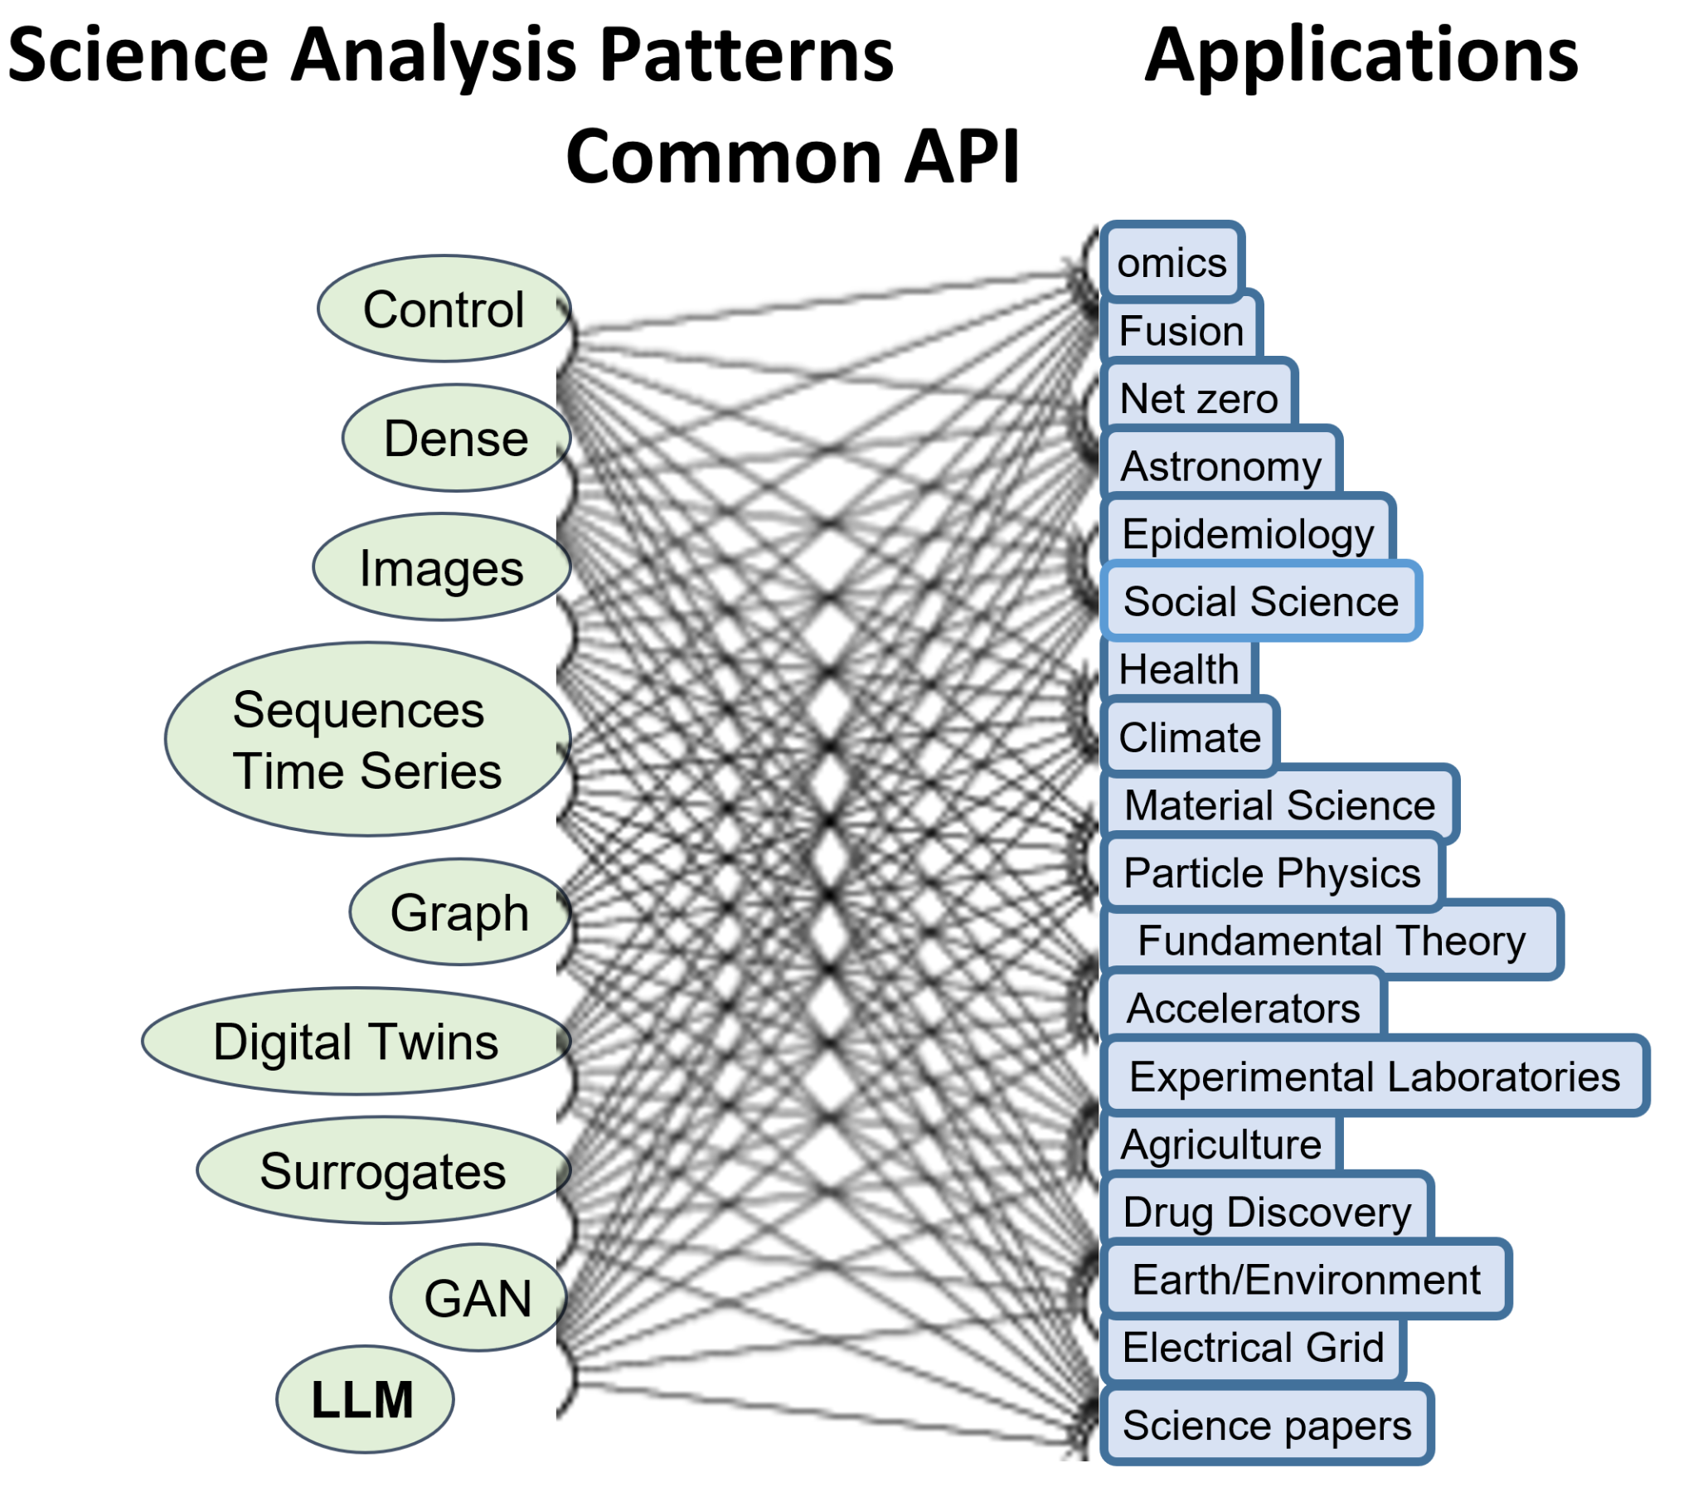
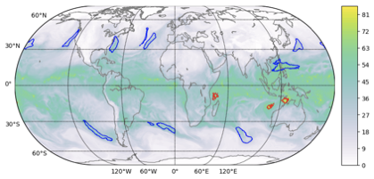
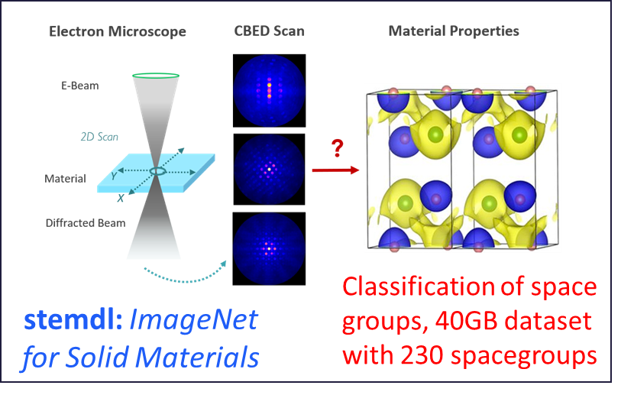
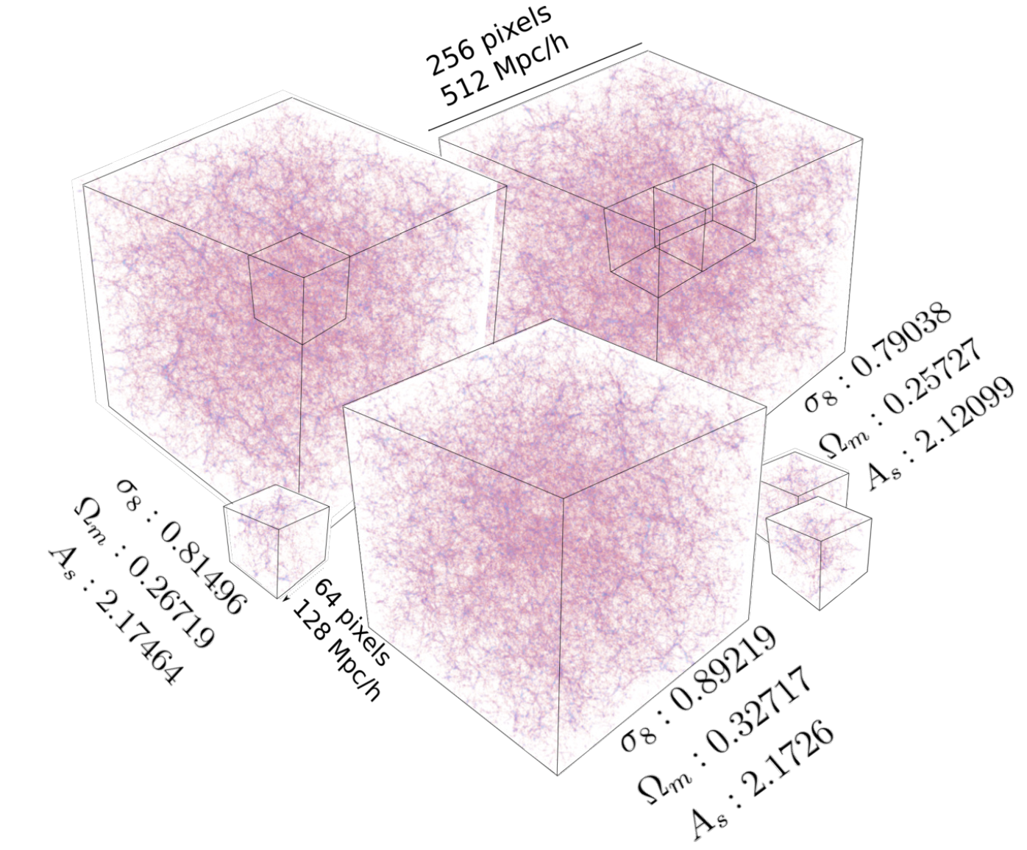
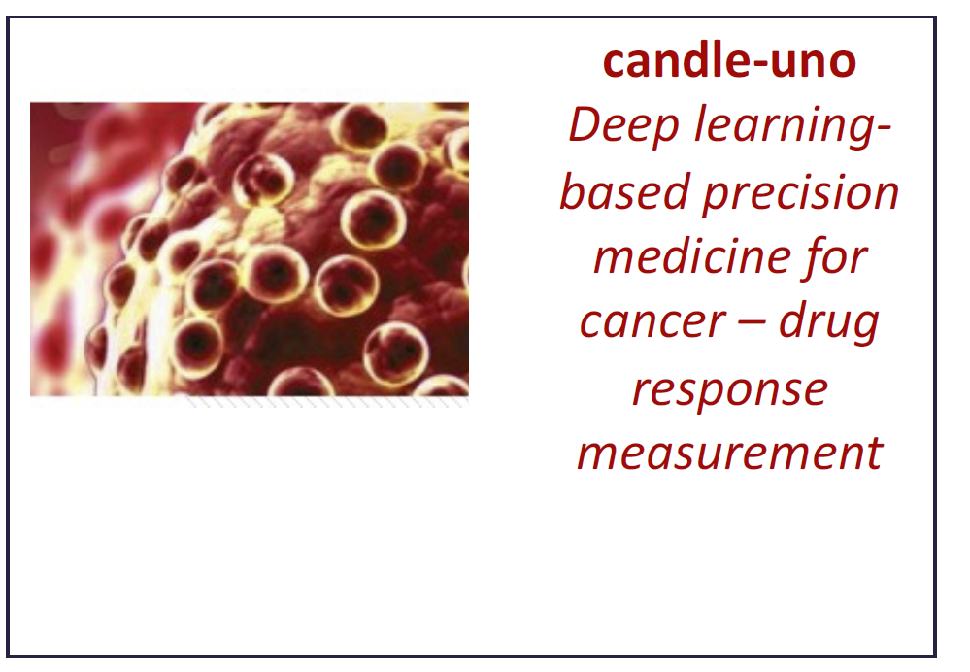
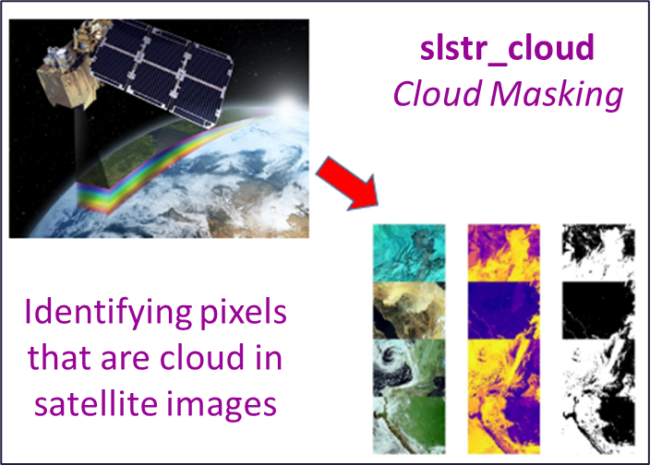
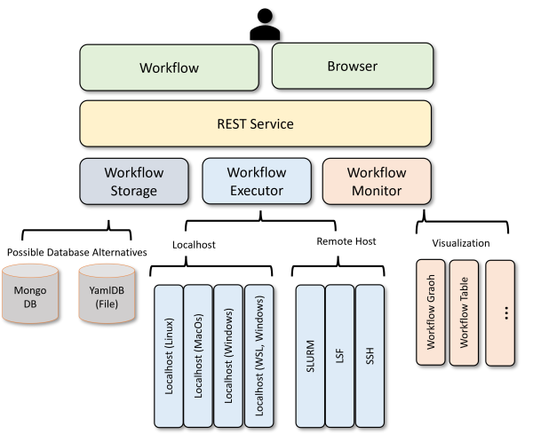
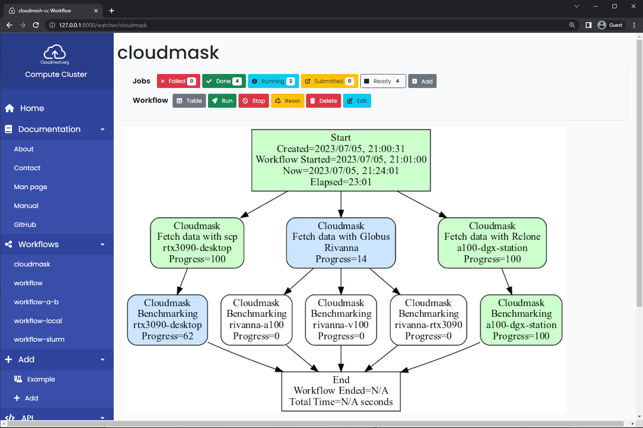
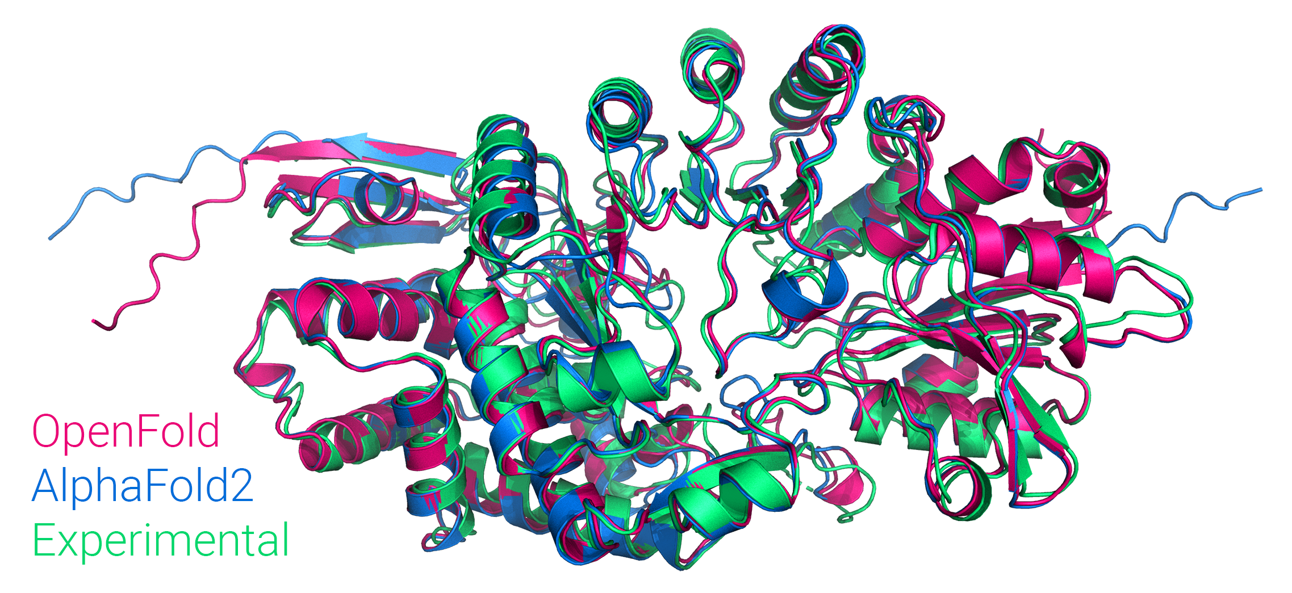
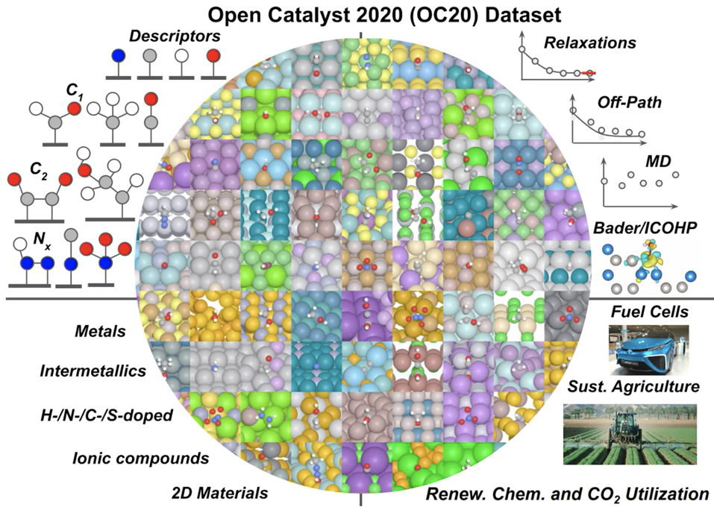
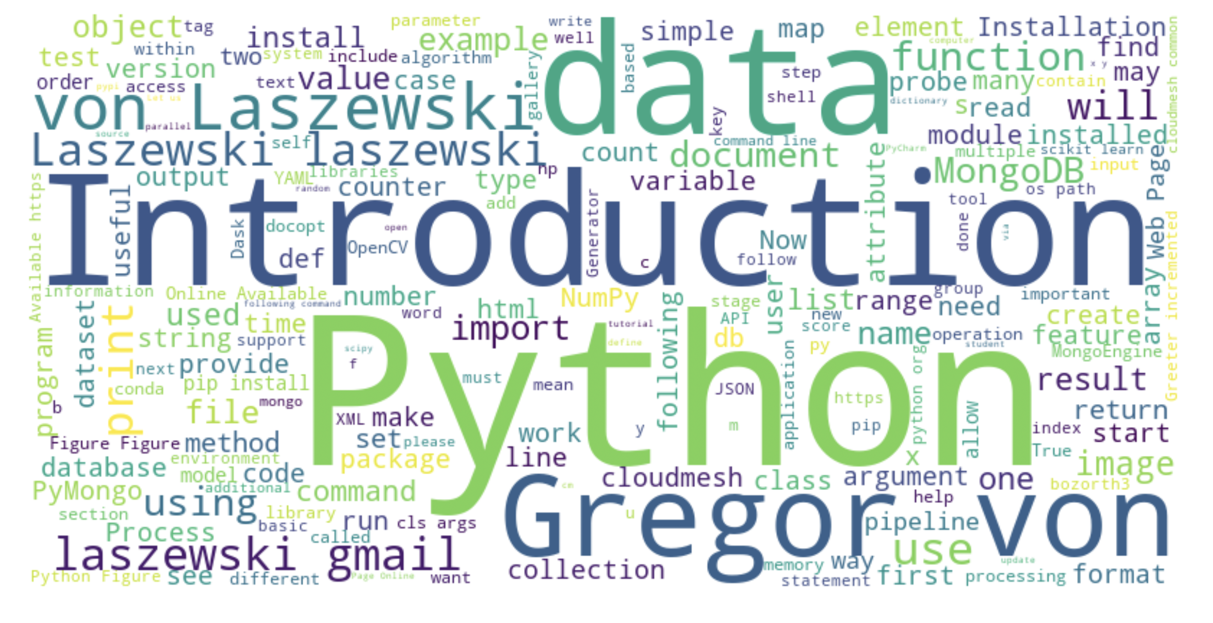
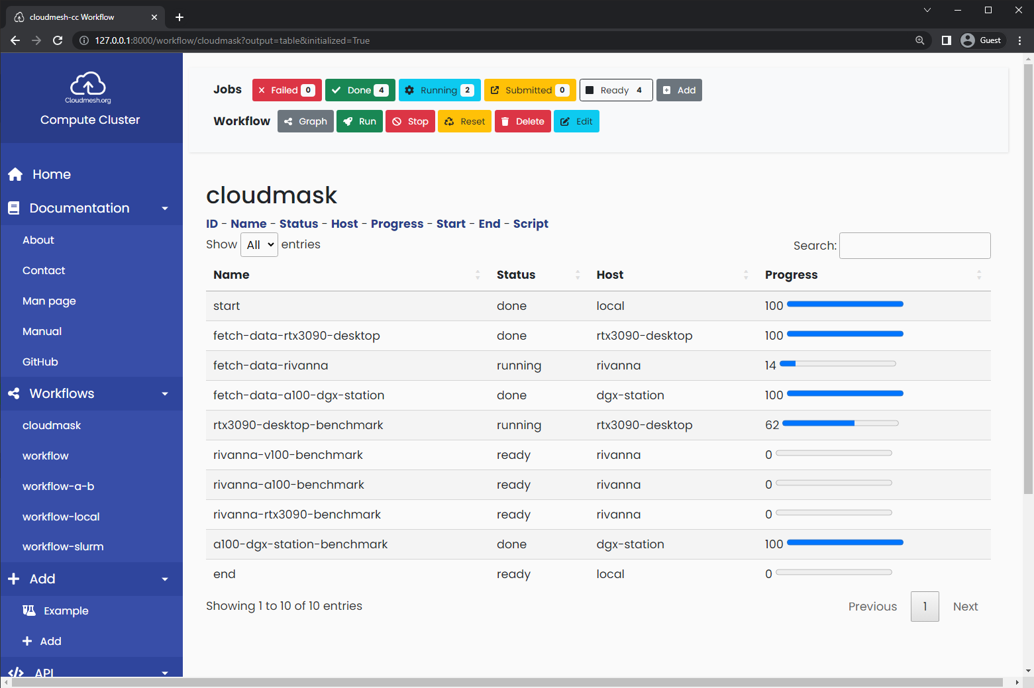
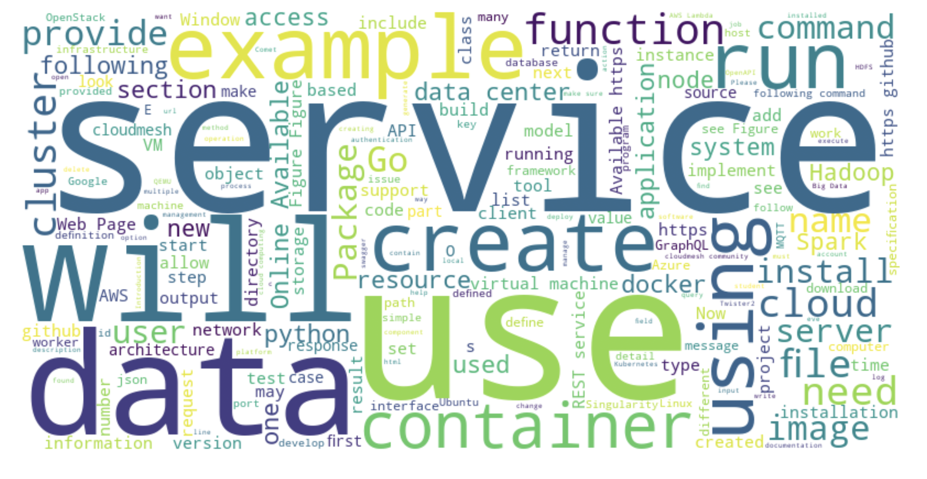
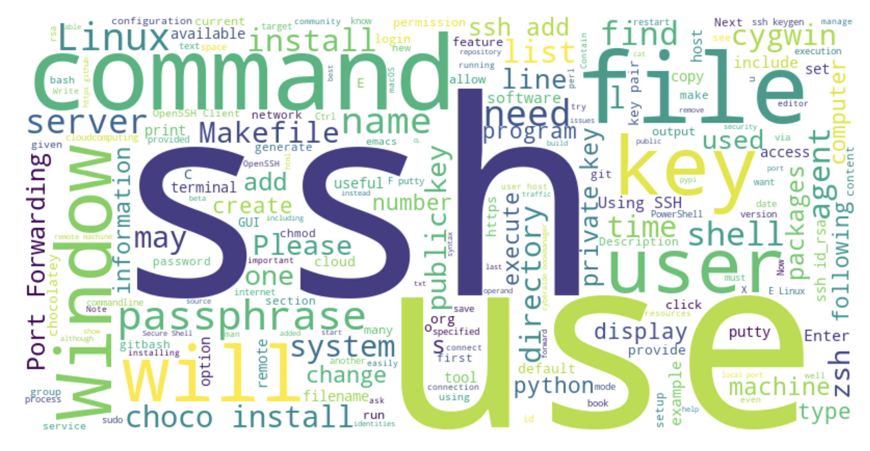
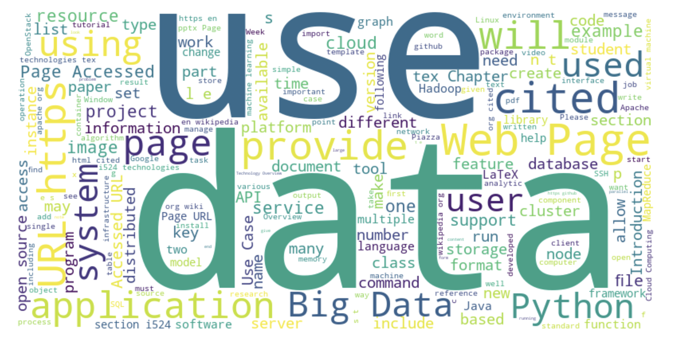
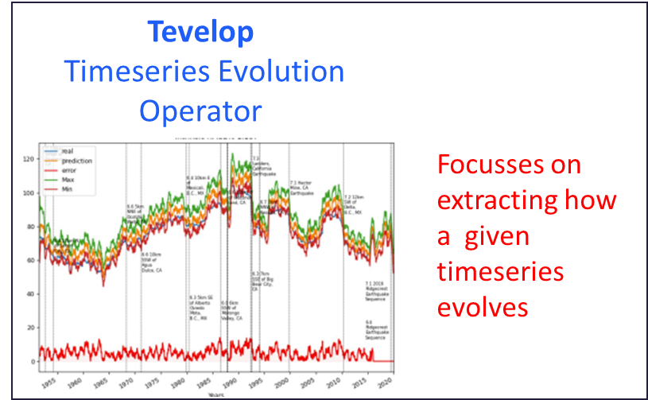
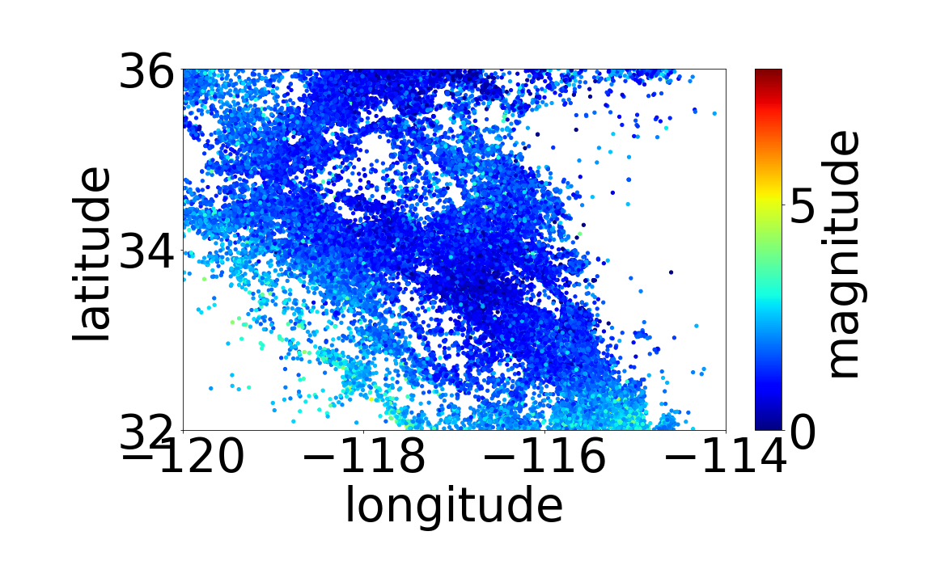



CyberTraining and Technologies for Students from Generation Z
AI for Science and Engineering
Highlights
> 200 undergraduate applied Fall 22-Summer 23; > 50 applied Fall 2023
> 2000 pages educational material
> 170 repositories
Interaction of MLCommons applications
Significant technology development
Hybrid cloud computing interface
Benchmarking
GPU use
Experiment management & Compute resource coordination
Online and PDF material publication framework
Individually customizable training material selection and production
Geoffrey C. Fox, Gregor von Laszewski
vxj6mb@virginia.edu, gregor@virginia.edu
Need for students to be familiar with
Cyberinfrastructure,
Science applications,
Artificial intelligence.
Concepts can be taught together as integrated holistic approach
Outcome: a well-educated workforce useful for research, government, and industry.
Rapid changes in these fields require quick adaptation of material
Different backgrounds of students require customization of material
We developed open-source framework and tools that allow customized material to be given to each student after evaluation.
All material is publicly available under Open-Source License.
Cyberinfrastructure Training 90% CI 10% AI4Sci
CyberTraining for AI for Engineering and Science 50% CI 50% AI4Sci
AI for Science Training 10% CI 90% AI4Sci
DeepCAM Climate
Multi-modal Science Foundation Models
Selected topics include 2000 Pages of material organized by focus topics:
Introduction of Python for AI for Science
Cloud Computing,
HPC Computing,
Big Data Applications and Analytics,
Artificial Intelligence/Machine Learning.
stemdl
Cosmoflow Universe
Candle-Uno Drug Discovery
MLCommons AI4Science
And HPC Benchmarks
MLCommons Cloudmasking Using Cloudmesh Experiment Execution
Cloudmesh
Compute
Coordinator
GNN Chemistry
Architecture
Openfold Protein Structure
MLCommons Earthquake using Tevelop
Impact of Hyperparameter
controlling inputs and outputs
Earthquake data
GPU Performance
Energy traces
NSF 2200409 (Virginia)
NSF 1829704 (Indiana)
BIOCOMPLEXITY INSTITUTE

